Slide 1
Predicting Algae Bloom
By:
Kushboo Jha
Notes:
This presentation discusses predicting algae bloom.

Slide 2
Outline
Background
Objective
Dataset
Models Used
Training Dataset Analysis
Model Analysis
Conclusion
Notes:
In this presentation we will be discussing background, objective, dataset, models used, training dataset analysis, model analysis for prediction and our conclusion. We will first discuss the background of freshwater algae

Slide 3
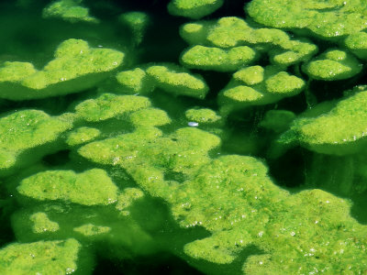
Our focus will be on freshwater algae
Primitive
One-celled or multicellular
Both marine and freshwater algae
Freshwater Algae
Dataset
Models Used
Training Dataset Analysis
Model Analysis
Conclusion
Source: http://www.ecy.wa.gov/programs/wq/plants/algae/lakes/AlgaeInformation.html
Notes:
Algae are primitive, and primarily aquatic. They could be one-celled or multicellular plant-like organisms that lack true stems, roots, and leaves but usually contain chlorophyll. There are both marine and freshwater algae, and algae are found almost everywhere on earth.
The focus on this presentation will be on freshwater algae

Slide 4

Monitoring algae blooms is important, we will be predicting the frequency of algae bloom
Preprocessing Data
Exploratory Data Analysis
Predictive Model Construction
High concentrations
of algae
Adversely affects
quality of water
Background
Objective
Dataset
Models Used
Training Dataset Analysis
Model Analysis
Conclusion
Notes:
*High concentrations of certain harmful algae in rivers constitute a serious ecological problem with a strong impact not only on river lifeforms, but also on water quality.
*Being able to monitor and perform an early forecast of algae blooms is essential to improving the quality of rivers.
We will be addressing the problem of predicting the frequency occurrence of several harmful algae in water samples. Doing so will be vital in keeping our rivers clean and keep our water supply safe.
In order to do this we will be using some basic data mining strategies, including pre-processing our data, exploratory data analysis and predictive model construction

Slide 5
Several factors are significant to this analysis, and understanding factors affecting the frequencies of algae is important
Season of the year
River size
River Speed
Frequency of seven harmful algae
Frequency
Factors
Background
Objective
Models Used
Training Dataset Analysis
Model Analysis
Conclusion
Dataset
Notes:
With the goal of addressing this prediction problem, several water samples were collected in different European rivers at different times during a period of approximately 1 year.
For each water sample, different chemical properties were measured as well as the frequency of occurrence of seven harmful algae.
Some other characteristics of the water collection process were also stored, such as the season of the year, the river size, and the river speed.
One of the main motivations behind this application lies in the fact that chemical monitoring is cheap and easily automated, while the biological analysis of the samples to identify the algae that are present in the water involves microscopic examination, requires trained manpower, and is therefore both expensive and slow.
As such, obtaining models that are able to accurately predict the algae frequencies based on chemical properties would facilitate the creation of cheap and automated systems for monitoring harmful algae blooms.
We also a better understanding of the factors influencing the algae frequencies. Namely, we want to understand how these frequencies are related to certain chemical attributes of water samples as well as other characteristics of the samples (like season of the year, type of river, etc.).

Slide 6
Two datasets are used in this analysis
1st Dataset
200 water samples
Same River
Same season of the year
Each observation contains information on 11 variables
Period of 3 months
Training Set
2nd Dataset
140 extra observations
No information on 7 harmful algae frequencies
Test Set
Background
Objective
Dataset
Models Used
Training Dataset Analysis
Model Analysis
Conclusion
Notes:
Two datasets are used in this analysis.
The first dataset includes 200 water samples. . Each observation in the datasets is an aggregation of several water samples collected from the same river over a period of 3 months, during the same season of the year.
Three of these variables are qualitative/categorical(nominal) and describe the season of the year when the water samples to be aggregated were collected, as well as the size and speed of the river in question. The eight remaining variables are values of different chemical parameters measured in the water samples forming the aggregation, namely:
-maximum pH value
Minimum value of oxygen
Mean value of chloride
Mean value of nitrates
Mean value of ammonium
Mean of orthophosphate
Mean of total phosphate
Mean of chlorophyll
The second dataset contains information on 140 extra observations.
It uses the same basic structure but it does not include information concerning the seven harmful algae frequencies.
These extra observations can be regarded as a kind of test set. The main goal of our study is to predict the frequencies of the seven algae for these 140 water samples.
In this type of task, our main goal is to obtain a model that allows us to predict the value of a certain target variable given the values of a set of predictor variables. This model may also provide indications on which predictor variables have a larger impact on the target variable; that is, the model may provide a comprehensive description of the factors that influence the target variable.

Slide 7
Three are models used in this analysis: Multiple Linear Regression, Regression tree and Random Forest
Tree 1
Tree 2
Multiple Linear Regression
Random Forest
Regression Tree
Background
Objective
Dataset
Models Used
Training Dataset Analysis
Model Analysis
Conclusion
Notes:
Multiple linear regression attempts to model the correlation between more than one explanatory variable, and a response variable. The value of the independent variable is associated with a value of the dependent variable.
In our case, few of the explanatory variables listed below are changes in temperature and PH levels of the water. While the response variable is the growth of Algae in this ideal environment
Regression tree methodology allows input variables to be a mixture of continuous and categorical variables. A decision tree is generated when each decision node in the tree contains a test on some input variable's value. The terminal nodes of the tree contain the predicted output variable values. In our study we have three categorical variable which include the seasons in the year, the size and the speed of the river the sample was collected from. The remaining eight are continuous variables.
Since regression tree does not handle unknown variables and the training set would have over fit our study it was not the best option to use.
Random forests is an ensemble learning method for classification, regression and other tasks, that operate by constructing a multitude of decision trees at training time and outputting the class that is the mode of mean prediction (regression) of the individual trees. Random decision forests correct for decision trees' habit of overfitting to their training set. Due to regression tree routine of over fit our data set we decided to use random forest that corrects the overfitting problem we face with regression trees.
Random forest as opposed to regression tree chooses from a random subset of attributes which helps with our data set that has few unknown variables.

Slide 8
Initial Data Analysis
Training Set: 200 samples
Test Set:
140 samples
Most data collected in winter
Autumn: 40
Spring: 53
Summer: 45
Winter: 62
Background
Objective
Dataset
Models Used
Training Dataset Analysis
Model Analysis
Conclusion
Notes:
We looked at the data briefly so that we can understand what kind of dataset we are working with. As we stated previously the training data set has 200 water samples and the test data set has 140 water samples. Also we observed that more samples were collected in the winter than any other season.

Slide 9
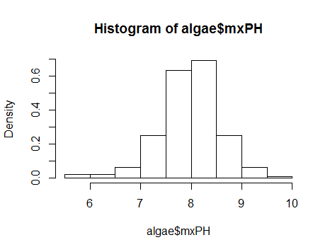
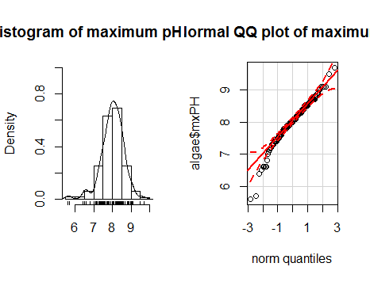
*Very near to normal distribution
Despite normal distribution, several variables significantly smaller than all others
Histogram: Maximum pH value
Normal QQ Plot: Maximum pH
Figure B
Figure C
Figure A
Background
Objective
Dataset
Models Used
Training Dataset Analysis
Model Analysis
Conclusion
Notes:
Figure A tells us that the values of variable mxPH apparently follow a distribution very near the normal distribution, with the values nicely clustered around the mean value.
However taking a closer look at the histograms in Figures B and C we can observe that there are two values significantly smaller than all others.
The second graph shows a Q-Q plot obtained with the qq.plot() function, which plots the variable values against the theoretical quantiles of a normal distribution (solid black line). The function also plots an envelope with the 95% confidence interval of the normal
distribution (dashed lines). As we can observe, there are several low values of the variable that clearly break the assumptions of a normal distribution with 95% confidence.

Slide 10
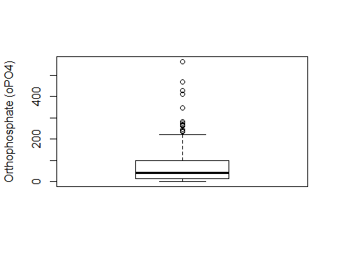
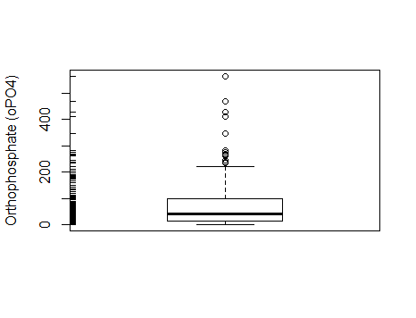
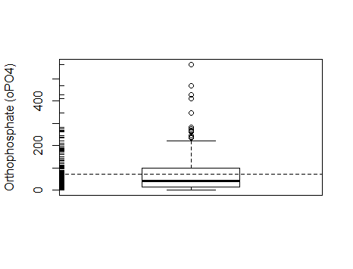
Orthophosphate box plot detects eventual outliers
Figure 1
Figure 2
Figure 3
Concentration is on low values!
Background
Objective
Dataset
Models Used
Training Dataset Analysis
Model Analysis
Conclusion
Notes:
An “enriched” box plot for orthophosphate box plots give us plenty of information regarding not only the central value and spread of the variable, but also eventual outliers. The analysis of Figure 1 , 2 and 3 show us that the variable oPO4 has a distribution of the observed values clearly concentrated on low values, thus with a positive skew. In most of the water samples, the value of oPO4 is low, but there are several observations with high values, and even with extremely high values.

Slide 11
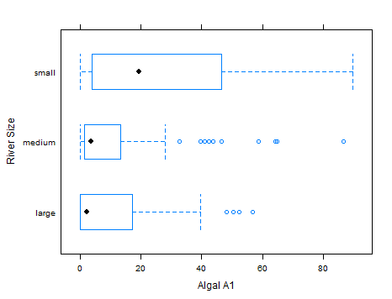
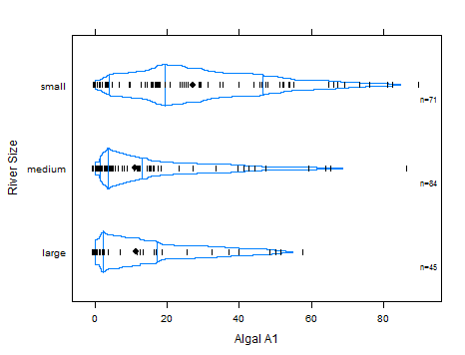
Higher frequencies of Algal A1 is valuable information
Higher frequencies
of Algae A1
smaller rivers
Background
Objective
Dataset
Models Used
Training Dataset Analysis
Model Analysis
Conclusion
Notes:
The figures above allows us to observe that higher frequencies of algal a1 are expected in smaller rivers, which can be valuable knowledge. For instance, we can confirm our previous observation that smaller rivers have higher frequencies of this alga, but we can also observe that the value of the observed frequencies for these small rivers is much more widespread across the domain of frequencies than for other types of rivers.
For instance, we can confirm our previous observation that smaller rivers have higher frequencies of this alga, but we can also observe
that the value of the observed frequencies for these small rivers is much more widespread across the domain of frequencies than for other types of rivers.

Slide 12
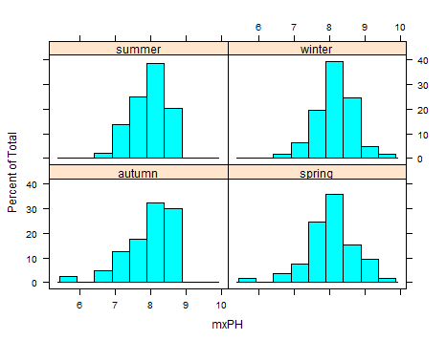

Removing unknown cases will improve the analysis
Background
Objective
Dataset
Models Used
Training Dataset Analysis
Model Analysis
Conclusion
Notes:
We will remove unknown cases by:
• Filling in the unknown values by exploring the correlations between variables.
• Filling in the unknown values by exploring the similarity between cases.
• Using tools that are able to handle these values.
Hence, we removed records 62, 199 as they had many unknown values (six of the eleven predictor variables missing) and fill rest of the unknown values using fill in the unknown values by exploring the similarity between cases.
This is done as the model we will be using i.e. Linear Regression not able to use datasets with unknown values,
THERE ARE 16 UNKNOWN CASES.
Looking at the cases with unknowns we can see that both the samples
62 and 199 have six of the eleven explanatory variables with unknown values.
In such cases, it is wise to simply ignore these observations by removing them
REMOVED RECORD 62, 199 UNKNOWN > 20%
Notice that the figure with the histograms above are rather similar, thus leading
us to conclude that the values of mxPH are not seriously influenced by the
season of the year when the samples were collected.

Slide 13
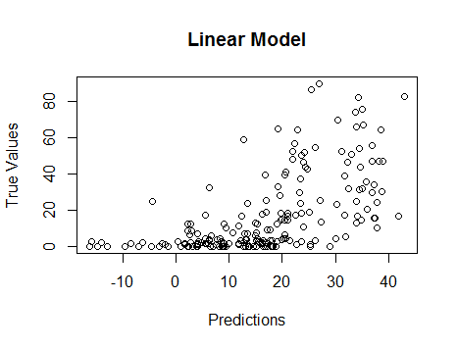
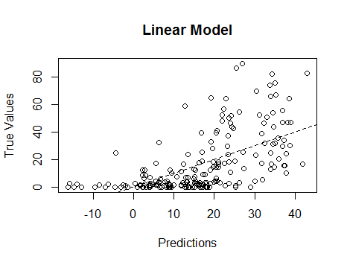

Linear Model is predicting <50% of the data accurately
Residual Standard Error | 17.65 on 182 degrees of freedom
Multiple R-squared | 0.3731
Adjusted R-squared | 0.3215
F-statistic | 7.223 on 15
P-value | 2.444e-12
Background
Objective
Dataset
Models Used
Training Dataset Analysis
Model Analysis
Conclusion
Notes:
Linear Regression Model
we want a model that predicts the variable a1 using all other variables present in the data,
Residual standard error: 17.65 on 182 degrees of freedom
Multiple R-squared: 0.3731, Adjusted R-squared: 0.3215
F-statistic: 7.223 on 15 and 182 DF, p-value: 2.444e-12
The proportion of variance explained by this model is not very impressive (around 32.0%).
To improve model fit we remove variable season as it least contributes to the reduction of the fitting error of the model.
Residual standard error: 17.57 on 185 degrees of freedom
Multiple R-squared: 0.3682, Adjusted R-squared: 0.3272
F-statistic: 8.984 on 12 and 185 DF, p-value: 1.762e-13
The fit has improved a bit (32.8%) but it is still not too impressive.
Make model even simple, result achieved:
Residual standard error: 17.5 on 191 degrees of freedom
Multiple R-squared: 0.3527, Adjusted R-squared: 0.3324
F-statistic: 17.35 on 6 and 191 DF, p-value: 5.554e-16
The proportion of variance explained by this model is still not very interesting.
Conclusion: linearity assumptions of this model are inadequate. Hence, we need to try another model.

Slide 14
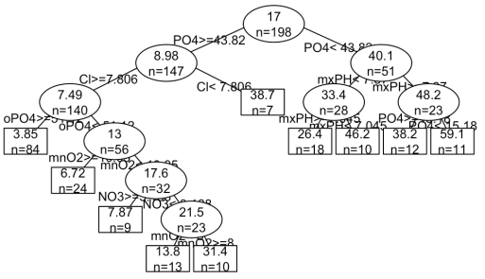
Regression tree model is too complex
Background
Objective
Dataset
Models Used
Training Dataset Analysis
Model Analysis
Conclusion
Notes:
Model obtained is complex. A large tree will fit the training data almost perfectly, but due to overfitting will perform badly when faced with a new data sample for which predictions are required. It needs to be pruned because it is too complex. After pruning we do the model evaluation we use NMSE(Normalized mean square error) and then we find that error is still too high.
Next we will compare it to the linear regression model

Slide 15
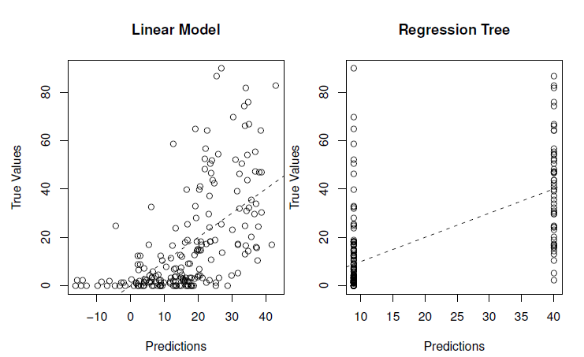
Both models yield poor outcomes
Linear Regression Model
Regression Tree
Background
Objective
Dataset
Models Used
Training Dataset Analysis
Model Analysis
Conclusion
Notes:
Scatter Plot helps us to compare Linear Model & Regression Tree and we conclude that none of the model gives us good prediction results as the plot is far away from regression line.
Switching to Random Forest.

Slide 16
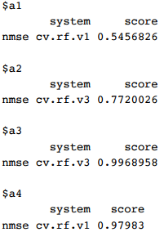
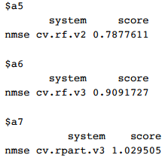
Random forest score(NMSE) is poor for all seven alga.
Notes:
On analyzing data using random forest technique, we get the different value from alga 1 to alga 7 . Alga 1 is good and rest are bad and a7 is worst, but still alga a1 has high NMSE score. In business term we can say this score if high shows bad prediction model. Hence discard this model as well.

Slide 17

Challenges
Linear Regression
Regression Tree
Random Forest
Notes:
Predictions for the Seven Algae
So, finally best of best model used nothing worked error still high

Slide 18
Conclusion
Ulterior methods need to be used but that is beyond the scope of this presentation.
Notes:
Although finding predicting concentration of certain algae in freshwater is important, none of the values used in this study were sufficient. Ulterior methods need to be used but that is beyond the scope of this presentation.

Slide 19
References
You tube videos.
Document made available for this assignment on blackboard.

